Slide 1
Unit Testing

Slide 2

Sprint Updates
Client Meetings
How have client meetings gone?
Any requirement changes?
Lab Advisors
Regular Lab advisor meeting?
Sprint Progress
Only a couple sprints left!
Any blockers?

Slide 3

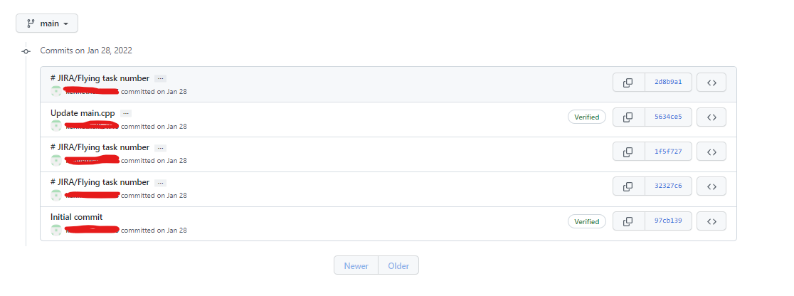
Git Screen Shots Execution Report
Click on the clock commits icon
Shows developers name, date of commit and JIRA task

Slide 4

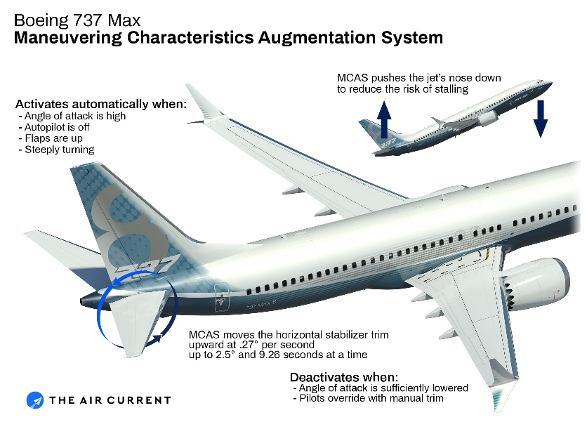
Why is Testing Important
Boeing 737 Max
MCAS system would check angle of attack sensor
If the angle of attack was too high the MCAS software would push the plane down to prevent an engine stall
AOA sensor was malfunctioning and MCAS pushed nose of plane down
How could this have been prevented??

Slide 5
Unit Testing
Testing that a function returns the proper value
A function output is expected to be a float but returns an int
Example: A order total function adds up all the ordered items and outputs a total to be used for billing. Since the output is an integer a whole number is delivered. As a result change is not calculated in the total, This error over time accumulates costing the company money.
A char value is too small
Example: A char 16 in the password function is not large enough to store the password, Some passwords are truncated but most passwords make it through ok.
A hashing algorithm returns inaccurate results
Example: A hash function returns a hash for a given password string. The hash function isn’t working correctly and returns a different hash for the same sting password. This causes the password verification function to fail

Slide 6
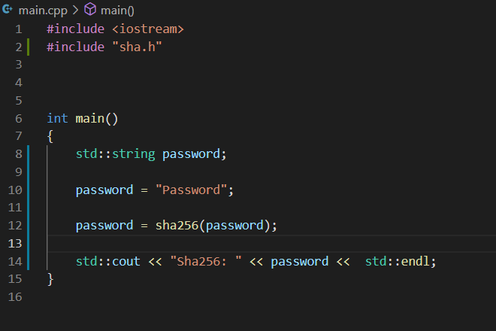
Simple Code Example
This cpp code has a function called sha256 that takes in a sting password
The output of the function sha256 returns a string Hash
This function is useful so that plain text passwords are not stored in the database
The password entered by the user can be checked against a hash

Slide 7
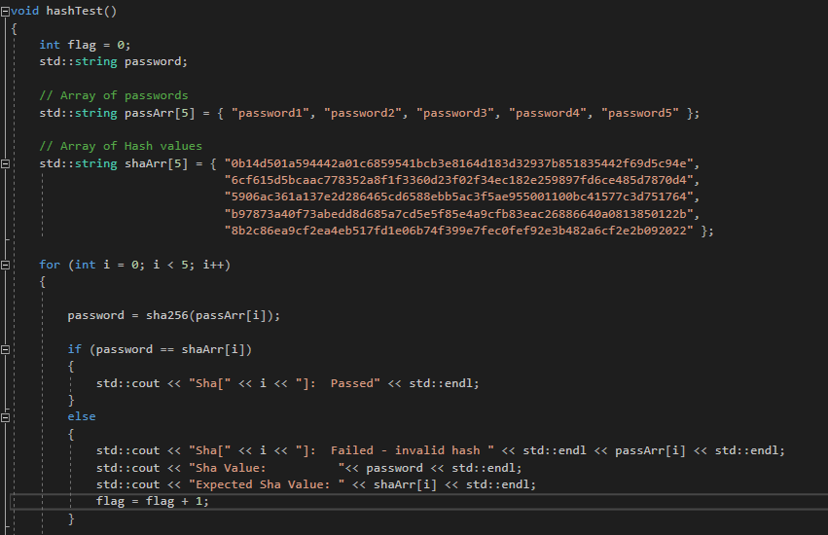
Simple Code Example
This hash unit test runs the hash function against a known password and hash
If the hash function returns and invalid hash the test will print to the screen the invalid hash
A pass fail indicator is also given

Slide 8
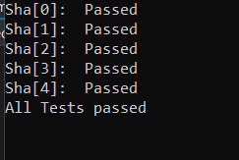
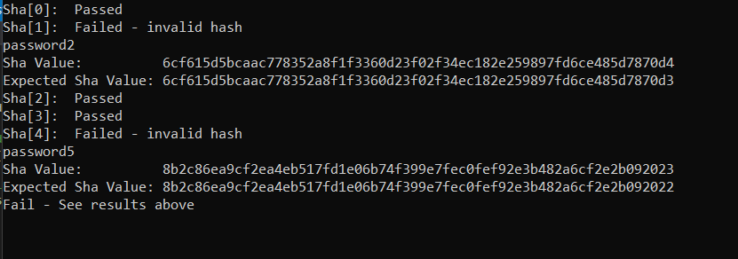
Simple Code Example
Fig. 1
Fig. 2
Figure #1 shows the test passed
All 5 passwords were hashed and their values matched the known hash table
Figure #2 shows the test failed
Some passwords were hashed correctly some failed the know hash match
Something in the SHA function must have been modified and the SHA function is no longer behaving as intended

Slide 9
Unit Testing
Testing the speed of a hashing algorithm
A hashing algorithm works fine during development but it is slow
The algorithm is within a password verification function
Unit testing shows that the slow speed is not noticeable even when the software must check 100 passwords in a row.
Testing the speed of an encryption algorithm
The encryption algorithm appears to be fast during development
The encryption algorithm is used in a function that encrypts medical documents before storing to the database
Unit testing reveals that the software is extremely sluggish when encrypting large amounts of medical records. The unit stress test failed and a different encryption algorithm will be used

Slide 10
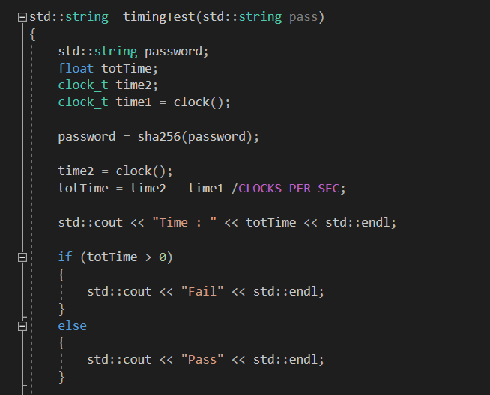
Unit Test Timing Example
This timingTest() function takes a password string as input and prints to the screen the clock cycles taken to preform the hash as well as a pass or fail
If the cycle times taken is greater than 0 the test will fail
These tests are useful when the hashing algorithm is changed speed differences can be seen

Slide 11

Unit Testing
Testing the speed of a database store or call function
Ensure that data stored or retrieved from the database arrives on time
If the software is reading and writing at volume the “lag” might not be noticed until the function is tested at volume.
Timing unit tests might be needed to ensure software tolerances are being met

Slide 12
Unit Testing
Testing the accuracy of a database store or call function
Ensure that data saved to the database is accurate
Ensure data retrieved from the database is accurate
Example: A unit test is created to call a function used by payroll accounting software. The results are compared to a known employee roster from. The test fails and its discovered a recent change in how new employees are saved into the database had broken the function that retrieves employees.

Slide 13
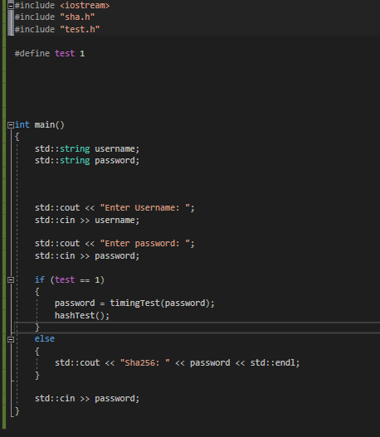
Embedding Unit Testing
Define Test
Test is defined to #1
This will trigger the testing logic below
If test is defined to anything else the tests will not be run
Embedding Unit test
Embedding unit tests and debug statements can be useful for troubleshooting and testing your code before deployment or git commits
Is Embedded Unit tests right for your team?
Is it feasible for your development language
Is it the right software for this type of testing
Should you create a separate git branch for testing and keep the development branch clean

Slide 14

Stubbing Code
Stubbing code
The section of code to be unit tested is removed from the development software into a stand alone program
The Stubbed code is then run against unit tests
Alternative to embedding unit tests in the baseline code
Code Stubbing is harder to maintain for testing
Code stubbing might be time consuming depending on the area of the code being stubbed
The more dependencies the module has the harder it will be to stub

Slide 15
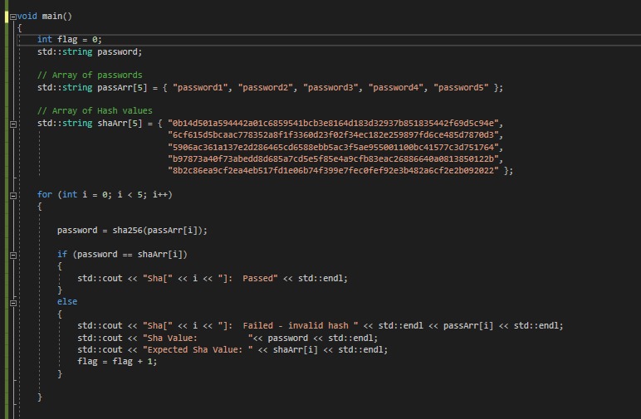
Stubbed Code Example
Main program
Module to be tested SHA256
The module is removed from the main program and stubbed
All required dependencies are moved into the program
Test wrapper
Main program
Associated test wrapper
No other code is present
Only the module to be tested is stubbed no other module is needed.

Slide 16

Unit Testing Recap
Unit testing should be preformed at the end of development before submitting your code to the git repository
The developer should design and run their own unit tests on the code they developed
Towards the end of the sprint during the team code review the developer should explain their code and the unit test they used to test
The team should decide how to incorporate the unit test into further integration tests and test automation

